Slide 1
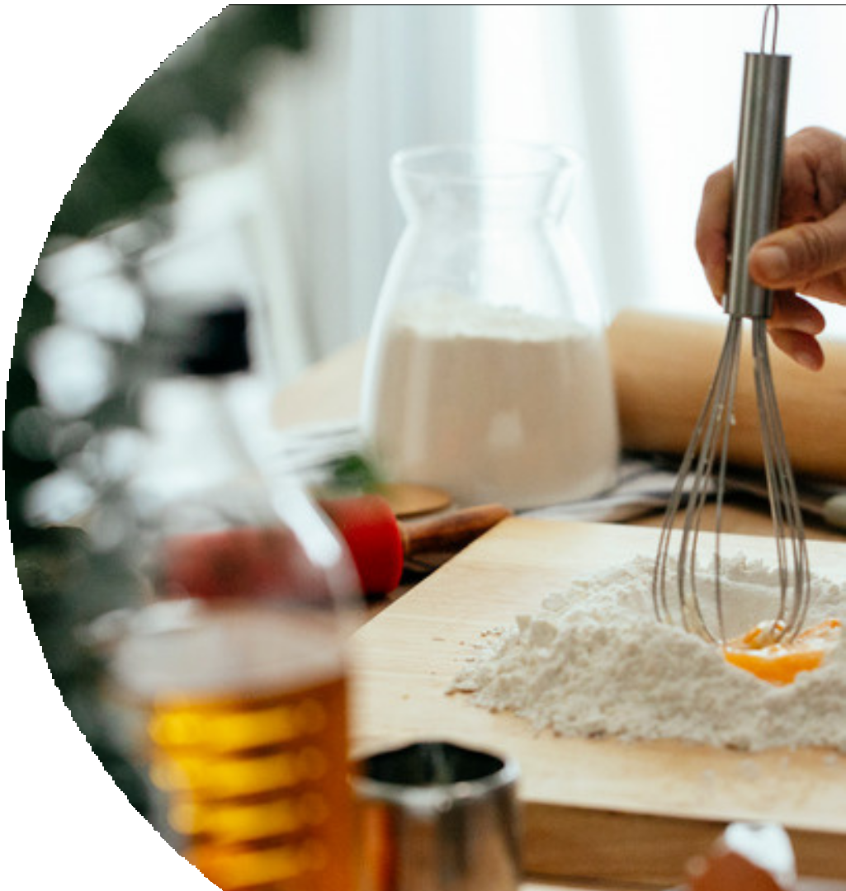

WEB TECHNOLOGY
Target-3
Recipe Sharing Website
Batch-17

Slide 2






Batch Members:
Shanmukha Sudha Kiran . T - 211 FA 04003 Ravi Kiran. K- 211 FA 04043
Deepthi . U - 211 FA 04046
sahil RAJ - 211 FA 04677
R e c i p e s h a r i n g w e b s i t e
WATCH NOW

Slide 3
AIM:
Design a website where users can share and discover recipes. Include features like user profiles, recipe submissions, search functionality, ratings and reviews, and the ability to save favorite recipes. A recipe sharing website is an online platform where users can discover, share, and discuss recipes. It provides a space for individuals to showcase their culinary creations, find inspiration from others, and engage with a community of food enthusiasts. Recipe sharing websites typically offer features and functionalities that facilitate the sharing, organization, and exploration of recipes. Recipe sharing websites typically offer a range of features to allow users to discover, share, and explore recipes

Slide 4
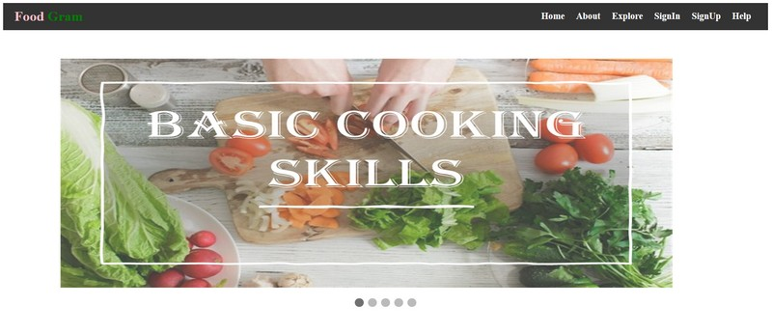
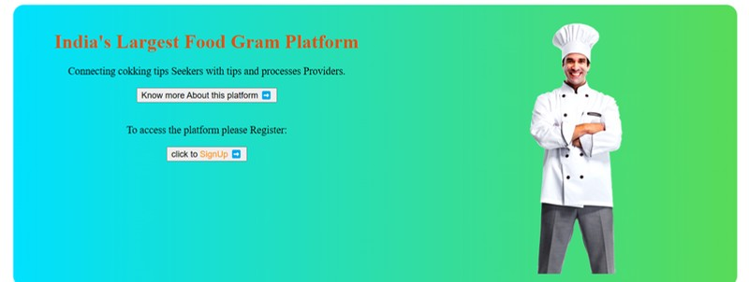
Home.html
<!DOCTYPE html>
<head>
<title>Home page</title>
<link href="navigation.css" rel="stylesheet">
</head>
<body>
<nav class="navbar" ><div class="logo">
<a href="index.jsp"><kk style="color: pink;">Food</kk> <span
style="color: green;">Gram</span></a>
</div>
<ul class="nav-links">
<li><a href="index.html">Home</a></li>
<li><a href="about.html">About</a></li>
<!--add required one-->
<script>
</ul>
let slideIndex = 0;
</nav>
<div class="background">
showSlides();
<div class="slideshow-container" style="margin-top: 50px;">
function showSlides() {
<div class="mySlides fade">
<img src="photos/p1img5.jpg" style="width:80%">
let i;
let slides = document.getElementsByClassName("mySlides");
</div>
let dots = document.getElementsByClassName("dot");
<div class="mySlides fade">
<img src="photos/p1img1.jpg" style="width:80%"></div>
for (i = 0; i < slides.length; i++) {
</div><div style="text-align:center">
slides[i].style.display = "none";
<span class="dot"></span>
<span class="dot"></span></div>
}
</div><div class="text" style="display: flex;flex-direction: row; justify-content:
slideIndex++;
center;text-align: center;margin-left: 90px;" >
if (slideIndex > slides.length) {slideIndex = 1}
<div>
for (i = 0; i < dots.length; i++) {
<h1>India's Largest Food Gram Platform</h1>
dots[i].className = dots[i].className.replace(" active",
<p>Connecting cokking tips Seekers with tips and processes Providers.</p>
<button id="but" type="submit">Know more About this platform ➡</button>
"");
<br><br>
}
<p>To access the platform please Register:</p>
slides[slideIndex-1].style.display = "block";
<button id="sign" type="submit">click to <spa style="color:
dots[slideIndex-1].className += " active";
darkorange">SignUp</spa> ➡</button><br>
setTimeout(showSlides, 1000); // Change image every 2
</div>
<div><img src="photos/chef.png"></div></div>
seconds
}
</script></body></html>

Slide 5

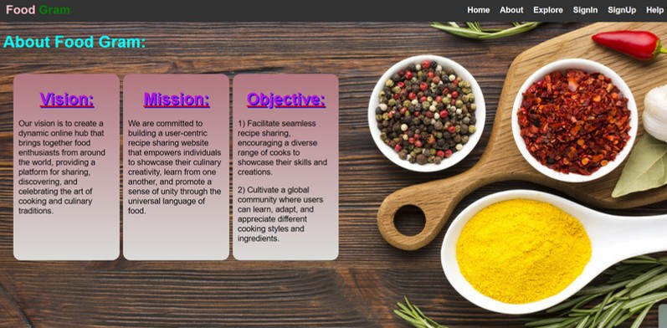

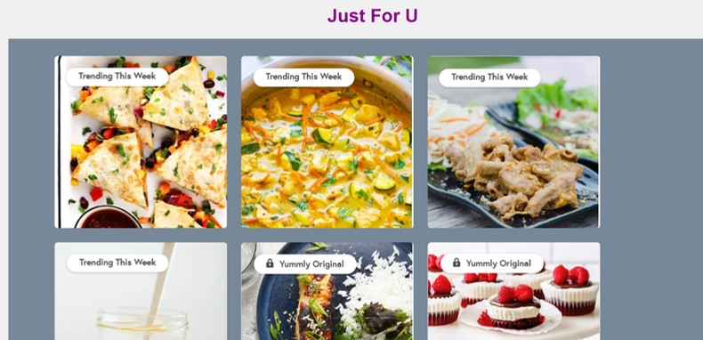
About.html
<html lang="en">
<head>
<title>Navigation Bar</title>
<link href="navigation.css" rel="stylesheet">
<link href='dropdown.css' rel='stylesheet'>
<!-- <style>add required styles</style> -->
</head>
<body>
<nav class="navbar">
<div class="logo">
<a href="p1.html"><kk style="color: pink;">Food</kk>
<span style="color: green;">Gram</span></a>
</div>
<ul class="nav-links">
<li><a href="index.html">Home</a></li>
<li><a href="about.html">About</a></li>
<!--add required navigation lines-->
</ul>
</nav>
<div>
<h1 style="margin-left: 15px; color:cyan;">About Food Gram:</h1>
</div>
<div class="a">
<div><h1>Vision:</h1>
<p>Our vision is to create a dynamic online hub that brings together food enthusiasts from around the world, providing a platform for sharing, discovering, and celebrating the art of cooking and culinary traditions.</p>
</div>
<div><h1>Mission:</h1>
<p>We are committed to building a user-centric recipe sharing website that empowers individuals to showcase their culinary creativity, learn from one another, and promote a sense of unity through the universal language of food.</p></div>
<div><h1>Objective:</h1>
<p>1) Facilitate seamless recipe sharing, encouraging a diverse range of cooks to showcase their skills and creations.</p>
<p>2) Cultivate a global community where users can learn, adapt, and appreciate different cooking styles and ingredients.</p></div></div>
<div style=" margin-left: 55px; margin-top: 199px; text-align: center;">
<h1 style="color:darkmagenta;text-shadow: 2px 2px 2px 2px;">Just For U</h1>
</div>
<div class="justforu">
<a href="signup.html"><img src="just/just1.png" alt="Click me" height="300px" width="300px"></a>
<a href="signup.html"><img src="just/just2.png" alt="Click me" height="300px" width="300px"></a>
</div></body>
</html>

Slide 6


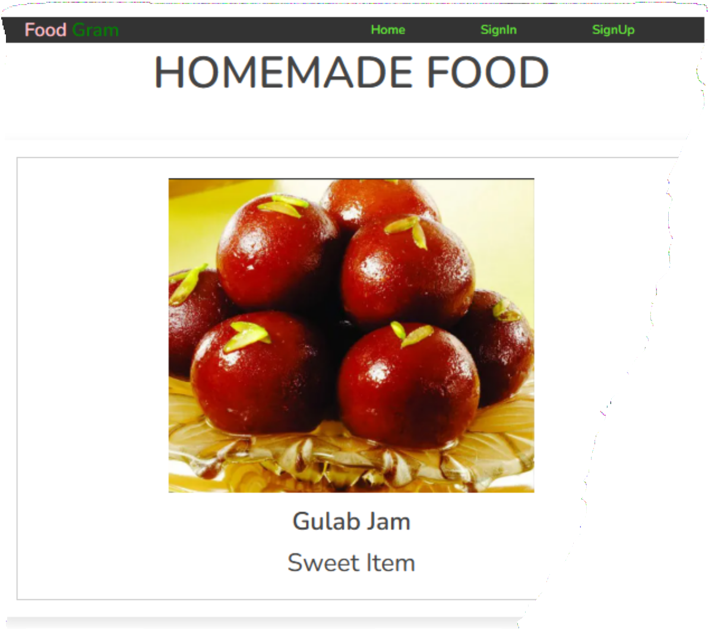
Explore.jsp
<%@ page language="java" contentType="text/html; charset=UTF-8" pageEncoding="UT 8"%>
<%@ page import="java.sql.*" %>
<!DOCTYPE html>
<html>
<head>
<title>Explore</title>
<link rel="stylesheet" href="explore.css">
<!--<style>adding styles</style>-->
</head>
<body>
<div class="container">
<nav class="navbar" >
<div class="logo">
<a href="p1.html"><kk style="color: pink;">Food</kk> <span style="color: green;">Gram</span></a></div>
<ul class="nav-links">
<li><a href="index.html" >Home</a></li>
</ul></nav>
<h3 class="title"> Homemade Food </h3>
<div class="products-container">
<div class="product" data-name="p-1">
<img src="sweets/gulabjamun1.png" alt="">
<h3>Gulab Jam</h3>
<div class="price">Sweet item</div></div>
<div class="product" data-name="p-5">
<ul class="event-list">
<%
String url = "jdbc:mysql://localhost:3306/register"; String user = "root";
String pass = "root";
try { Class.forName("com.mysql.cj.jdbc.Driver");
Connection connection = DriverManager.getConnection(url, user, pass);
String query = "SELECT * FROM addpost"; Statement statement = connection.createStatement(); ResultSet resultSet = statement.executeQuery(query); while (resultSet.next()) {
String recipename = resultSet.getString("recipe_name");
String recipetype = resultSet.getString("recipe_type"); String recipelink = resultSet.getString("recipe_link"); String recipedescription = resultSet.getString("recipe_description");
%>
<img src="<%= recipelink %>" alt="image of: <%= recipename %>">
<h3><%= recipename %></h3>
<h3><%= recipedescription %></h3>
<div class="price"><%= recipetype %></div>
<% }
resultSet.close(); statement.close(); connection.close();
} catch (ClassNotFoundException | SQLException e) {
e.printStackTrace();}
%>
</ul></div></div>
</div></body></html>

Slide 7




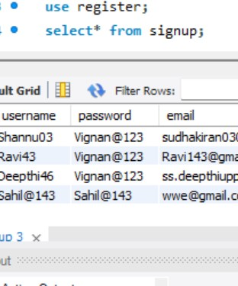
Signup.html
Signup. J s p
!DOCTYPE html> html lang="en"> head>
<link rel="stylesheet" href="styles.css">
<link rel="stylesheet" href="dropdown.css">
<link rel="stylesheet" href="navigation.css">
<title>Sign Up and Sign In</title>
<!--<style>adding style</style>-->
/head> body>
<nav class="navbar" ><div class="logo">
<a href="index.html"><kk style="color: pink;">Food</kk> <span style="color:
<%@ page import = "java.sql.*" %>
<%
String username = request.getParameter("username"); String password = request.getParameter("password"); String email = request.getParameter("email");
try {
Class.forName("com.mysql.cj.jdbc.Driver"); Connection conn =
DriverManager.getConnection("jdbc:mysql://localhost:/register", "root", "root");
PreparedStatement ps = conn.prepareStatement("insert into signup(username, password,email) values (?, ?, ?)");
ps.setString(1, username); ps.setString(2, password); ps.setString(3, email);
int x = ps.executeUpdate(); if (x > 0) {
response.sendRedirect("inner.html");}
else {
out.print("<html><body>"); out.println("<script>"); out.println("Registration failed");
out.print("window.location.href = 'signup.html';"); out.println("</script>"); out.println("</body></html>");}}
catch(Exception e) { out.println(e);}
%>
reen;">Gram</span></a>
</div>
<ul class="nav-links">
<li><a href="index.html">Home</a></li>
<li><a href="about.html">About</a></li>
<li><a href="help.html">Help</a></li>
</ul>
</nav>
<div class="header">
<img src="photos/logo.png" width="80px",height="70px" id="logo">
<marquee direction="right" width="80%" class="a"><h1>Online Food Recipe</h1>
/marquee></div>
<div class="container">
<div class="form-container"><h1>Sign Up</h1>
<form action="signup.jsp" method="post" id="myForm">
<input type="text" name="username" placeholder="Username" id="a"
ninput="user()" required><br>
<span style="color: red;" id="error1"></span><br>
<input type="password" name="password" placeholder="Password" id="b"
ninput="pass()" required><br>
<span style="color: red;" id="error2"></span><br>
<input type="email" name="email" placeholder="Email" id="c" oninput="mail()"
equired><br>
<span style="color: red;" id="error3"></span><br>
<button type="submit" id="sub">Sign Up</button><br> already have a account?<a href="signin.html">Login</a>
</form></div></div><script src="signup.js"></script>
/body>
/html>

Slide 8


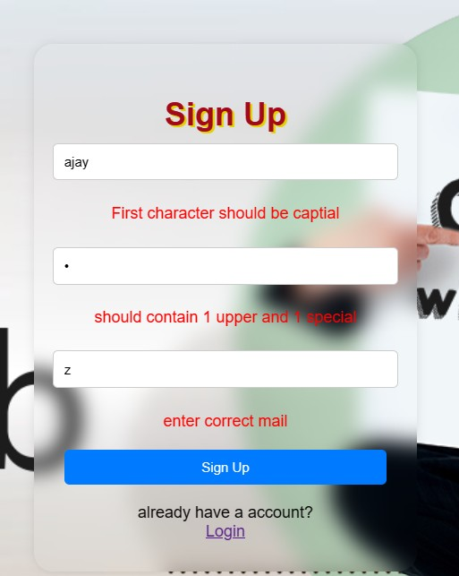
Signup. js
function user() {
var name = document.getElementById("a").value; var error1 = document.getElementById("error1"); let flag=0;
error1.innerHTML="First character should be captial"; if(name.length===0)
error1.innerHTML="";
else if(name[0]>='A' && name[0]<='Z')
{for(i=0;i<name.length;i++){ if(name[i]>='0' && name[i]<='9')
{error1.innerHTML=""; flag=1;}
else if(flag===1) error1.innerHTML=""; else
error1.innerHTML="Username should contain atleast one digit";}}else
error1.innerHTML = "First character should be captial";} function mail()
{var name2 = document.getElementById("c").value; var error3 = document.getElementById("error3"); if(name2==="")
error3.innerHTML=""; else{
var pattern = /^[a-zA-Z0-9._%+-]+@[a-zA-Z0-9.-]+\.[a-zA-Z]+$/; if(pattern.test(name2))
error3.innerHTML=""; else
error3.innerHTML="enter correct mail";}} document.getElementById("home").addEventListener("click", function() { window.location.href = "index.html"; // Replace with the desired URL
});
function pass()
{var name2 = document.getElementById("b").value; var error2 = document.getElementById("error2"); let i=0,f1=0,f2=0,f3=0;
var specialCharacters = "!@#$%^&*()_+{}[]:;<>,.?~\\/-="; if(name2.length===0)
error2.innerHTML=""; else{
for(i=0;i<name2.length;i++){ if((name2[i]>='A' && name2[i]<='Z'))
f1=1;
else if((name2[i]>='a' && name2[i]<='z') ) f2=1;
else if (specialCharacters.indexOf(name2[i]) !== -1) f3=1;
else
error2.innerHTML=""; if(f1===1 && f2===1 && f3===1)
error2.innerHTML=""; else if(f1===1 &&f3===1)
error2.innerHTML="should contain 1 lower case"; else if(f2===1 &&f3===1)
error2.innerHTML="should contain 1 uppercase letter"; else if(f1===1 && f2===1)
error2.innerHTML="should contain 1 special characters"; else if(f1===1)
error2.innerHTML="should contain 1 lower and 1 special"; else if(f2===1)
error2.innerHTML="should contain 1 upper and 1 special"; else if(f3===1)
error2.innerHTML="should contain 1 lower and 1 upper"; else
error2.innerHTML="should contain 1 uppercase letter and 1 lower case and 1
special "; }}}
document.getElementById("logo").addEventListener("click", function() { window.location.href = "index.html"; // Replace with the desired URL
});

Slide 9

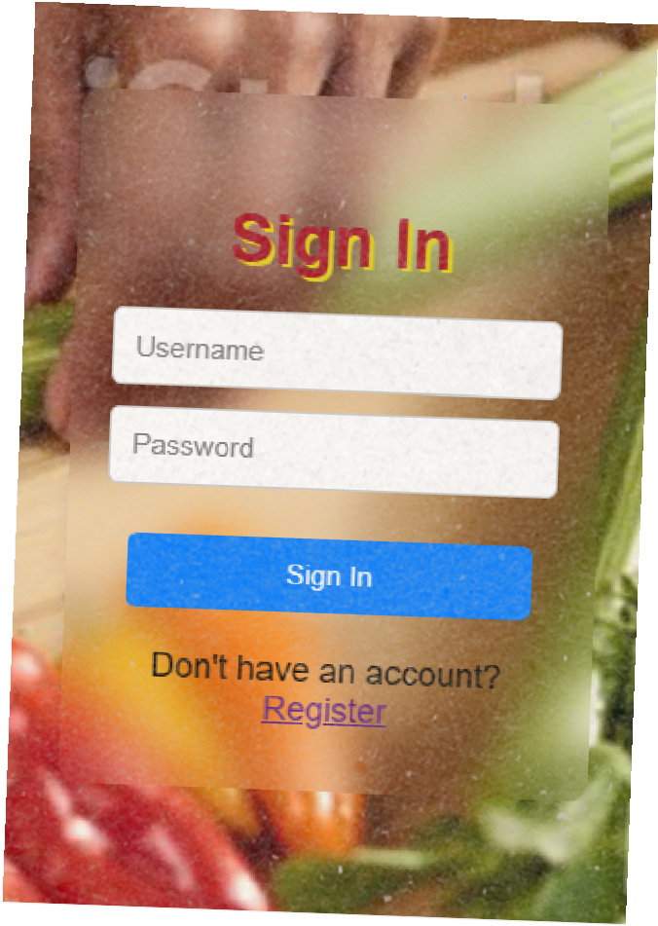



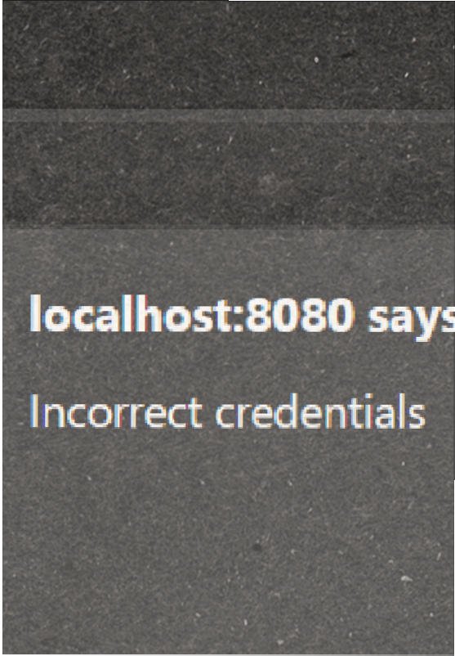
Signin. html
Signin.jsp
<!DOCTYPE html>
<html lang="en">
<head>
<link rel="stylesheet" href="dropdown.css">
<link rel="stylesheet" href="navigation.css">
<title>signin</title>
<!--<style>adding styles </style>-->
</head>
<body>
<div class="header">
<nav class="navbar" >
<div class="logo">
<a href="index.html"><kk style="color: pink;">Food</kk> <span style="color: green;">Gram</span></a>
</div>
<ul class="nav-links">
<li><a href="index.html">Home</a></li>
<li><a href="about.html">About</a></li></ul>
</nav>
<img src="photos/logo.png" width="80px",height="50px" id="logo">
<marquee direction="left" width="80%" class="a"><h1>Online Food Recipe</h1></marquee></div>
<div class="container">
<div class="form-container">
<h1>Sign In</h1>
<form action="signin.jsp" method="post" id="myForm">
<input type="text" name="username" placeholder="Username" required>
<input type="password" name="password" placeholder="Password" required><br>
<button type="submit">Sign In</button><br> Don't have an account?<a href="signup.html">Register</a>
</form></div></div>
<script> document.getElementById("logo").addEventListener("click",
function() {
window.location.href = "index.html"; // Replace with the desired
URL
});</script>
</body>
</html>
<%@ page import="java.sql.*" %>
<%
String enteredUsername=request.getParameter(" username");
String
enteredPassword=request.getParameter("p assword");
try {
Class.forName("com.mysql.jdbc.Driver");
Connection conn=DriverManager.getConnection("jdbc:m ysql://localhost:3306/register", "root" , "root" );
PreparedStatement
ps=conn.prepareStatement("select * from signup where username=? and password=?");
ps.setString(1, enteredUsername);
ps.setString(2, enteredPassword); ResultSet rs=ps.executeQuery(); if (rs.next()) {
response.sendRedirect("inner.html");}
else { out.print("<html><body>"); out.println("<script>"); out.println("alert('Incorrect
credentials')");
out.print("window.location.href = 'signin.html';");
out.println("</script>");
out.println("</body></html>");}
} catch (Exception e) { out.println(e); }
%>

Slide 10

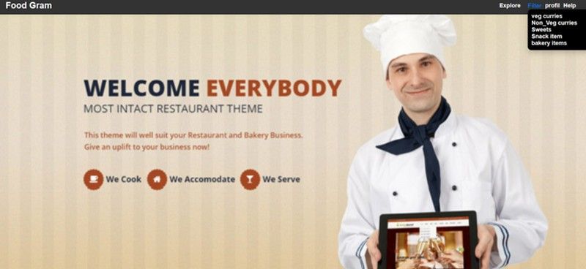
Inner. html
<!DOCTYPE html>
<html lang="en">
<head>
<title>Navigation Bar</title>
<link rel="stylesheet" href="dropdown.css">
<link rel="stylesheet" href="navigation.css">
</head>
<body>
<nav class="navbar">
<div class="logo">
<a href="index.html"><span class="logo-text">Food</span> <span class="logo- text-green">Gram</span></a>
</div>
<ul class="nav-links">
<li><a href="explore1.jsp">Explore</a></li>
<li><div class="dropdown">
<a href="#" class="dropbtn">Filter</a>
<div class="dropdown-content">
<a href="veg.html">veg curries</a><br>
<a href="nonveg.html">Non_Veg curries</a><br>
<a href="sweets.html">Sweets</a><br>
<a href="snack_items.html">Snack item</a><br>
<a href="bakery_items.html">bakery items</a>
</div></div></li>
<li><div class="dropdown">
<a href="#" class="dropbtn">profil</a>
<div class="dropdown-content">
<!--
<a href="posts.html">posts</a><br>-->
<a href="addpost.html">Add post</a><br>
<a href="wishlist.html">Wishlist</a><br>-->
<a href="index.html">Logout</a><br>
</div></div></li>
<!--
<li><a href="help2.html">Help</a></li></ul></nav>
</body>
</html>

Slide 11
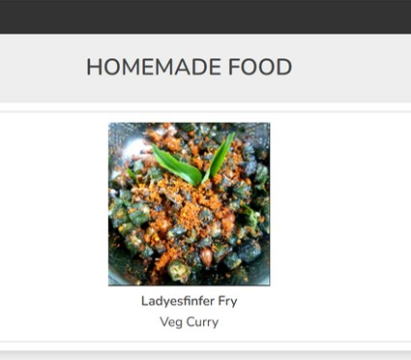


veg.html
<html lang="en">
<head>
<link rel="stylesheet" href="explore.css">
<link href="navigation.css" rel="stylesheet">
</head>
<body>
<div class="container">
<nav class="navbar" >
<div class="logo">
<a href="index.html"><kk style="color: pink;">Food</kk> <span style="color: green;">Gram</span></a></div>
<ul class="nav-links"><li><a href="inner.html">Back</a></li></ul>
</nav><br><br>
<h3 class="title"> Homemade Food </h3>
<div class="products-container">
<div class="product" data-name="p-2">
<img src="veg/layesfinger_fry1.png" alt="">
<h3>Ladyesfinfer fry</h3>
<div class="price">Veg Curry</div>
</div> </div></div>
<div class="products-preview">
<div class="preview" data-target="p-2">
<i class="fas fa-times"></i>
<img src="veg/ladyesfinger_fry2.png" alt="">
<h3>LadyesFinger Fry</h3>
<div class="buttons">
<a href="veg.html" class="buy">back</a>
<a href="#" class="cart">add to wishlist</a>
</div></div></div>
<script>
let preveiwContainer = document.querySelector('.products-preview'); let previewBox = preveiwContainer.querySelectorAll('.preview');
document.querySelectorAll('.products-container .product').forEach(product =>{ product.onclick = () =>{
preveiwContainer.style.display = 'flex';
let name = product.getAttribute('data-name'); previewBox.forEach(preview =>{
let target = preview.getAttribute('data-target'); if(name === target){ preview.classList.add('active');
}});};});
previewBox.forEach(close =>{ close.querySelector('.fa-times').onclick = () =>{ close.classList.remove('active'); preveiwContainer.style.display = 'none'; };});
</script></body>
</html>

Slide 12
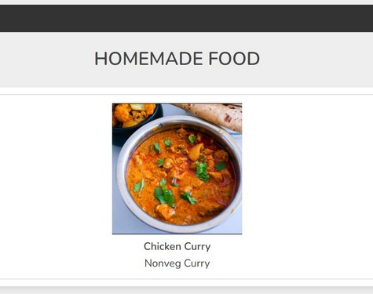

nonveg.html
<html lang="en">
<head>
<link rel="stylesheet" href="explore.css">
<link href="navigation.css" rel="stylesheet">
</head>
<body>
<div class="container">
<nav class="navbar" >
<div class="logo">
<a href="index.html"><kk style="color: pink;">Food</kk> <span style="color: green;">Gram</span></a></div>
<ul class="nav-links"><li><a href="inner.html">Back</a></li></ul>
</nav><br><br>
<h3 class="title"> Homemade Food </h3>
<div class="products-container">
<div class="product" data-name="p-2">
<img src="nonveg/chicken_curry1.png" alt="">
<h3>Chicken Curry</h3>
<div class="price">Nonveg Curry</div>
</div> </div></div>
<div class="products-preview">
<div class="preview" data-target="p-2">
<i class="fas fa-times"></i>
<img src="nonveg/chicken_curry2.png" alt="">
<h3>Chicken curry</h3>
<div class="buttons">
<a href="veg.html" class="buy">back</a>
<a href="#" class="cart">add to wishlist</a>
</div></div></div>
<script>
let preveiwContainer = document.querySelector('.products-preview'); let previewBox = preveiwContainer.querySelectorAll('.preview');
document.querySelectorAll('.products-container .product').forEach(product =>{ product.onclick = () =>{
preveiwContainer.style.display = 'flex';
let name = product.getAttribute('data-name'); previewBox.forEach(preview =>{
let target = preview.getAttribute('data-target'); if(name === target){ preview.classList.add('active');
}});};});
previewBox.forEach(close =>{ close.querySelector('.fa-times').onclick = () =>{ close.classList.remove('active'); preveiwContainer.style.display = 'none'; };});
</script></body>
</html>

Slide 13
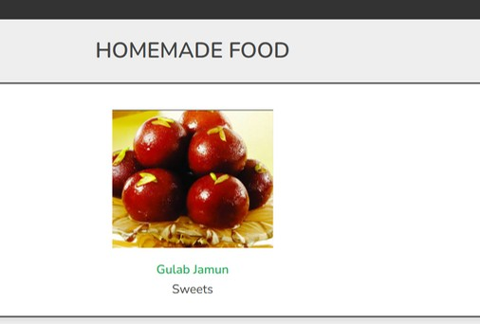
sweets.html
<html lang="en">
<head>
<link rel="stylesheet" href="explore.css">
<link href="navigation.css" rel="stylesheet">
</head>
<body>
<div class="container">
<nav class="navbar" >
<div class="logo">
<a href="index.html"><kk style="color: pink;">Food</kk> <span style="color: green;">Gram</span></a></div>
<ul class="nav-links"><li><a href="inner.html">Back</a></li></ul>
</nav><br><br>
<h3 class="title"> Homemade Food </h3>
<div class="products-container">
<div class="product" data-name="p-2">
<img src="sweets/gulabjamun1.png" alt="">
<h3>Gulab Jamun</h3>
<div class="price">sweets</div>
</div> </div></div>
<div class="products-preview">
<div class="preview" data-target="p-2">
<i class="fas fa-times"></i>
<img src="sweets/gulabjamun2.jpg" alt="">
<h3>Gulabjamun</h3>
<div class="buttons">
<a href="veg.html" class="buy">back</a>
<a href="#" class="cart">add to wishlist</a>
</div></div></div>
<script>
let preveiwContainer = document.querySelector('.products-preview'); let previewBox = preveiwContainer.querySelectorAll('.preview');
document.querySelectorAll('.products-container .product').forEach(product =>{ product.onclick = () =>{
preveiwContainer.style.display = 'flex';
let name = product.getAttribute('data-name'); previewBox.forEach(preview =>{
let target = preview.getAttribute('data-target'); if(name === target){ preview.classList.add('active');
}});};});
previewBox.forEach(close =>{ close.querySelector('.fa-times').onclick = () =>{ close.classList.remove('active'); preveiwContainer.style.display = 'none'; };});
</script></body>
</html>

Slide 14
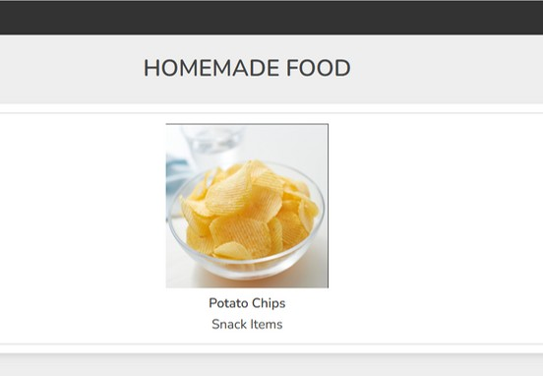
snack_item.html
<html lang="en">
<head>
<link rel="stylesheet" href="explore.css">
<link href="navigation.css" rel="stylesheet">
</head>
<body>
<div class="container">
<nav class="navbar" >
<div class="logo">
<a href="index.html"><kk style="color: pink;">Food</kk> <span style="color: green;">Gram</span></a></div>
<ul class="nav-links"><li><a href="inner.html">Back</a></li></ul>
</nav><br><br>
<h3 class="title"> Homemade Food </h3>
<div class="products-container">
<div class="product" data-name="p-2">
<img src="snack_items/chips1.png" alt="">
<h3>Potato chips</h3>
<div class="price">Snack Items</div>
</div> </div></div>
<div class="products-preview">
<div class="preview" data-target="p-2">
<i class="fas fa-times"></i>
<img src="snack_items/chips2.png" alt="">
<h3>Potato Chips</h3>
<div class="buttons">
<a href="snack_items.html" class="buy">back</a>
<a href="#" class="cart">add to wishlist</a>
</div></div></div>
<script>
let preveiwContainer = document.querySelector('.products-preview'); let previewBox = preveiwContainer.querySelectorAll('.preview');
document.querySelectorAll('.products-container .product').forEach(product =>{ product.onclick = () =>{
preveiwContainer.style.display = 'flex';
let name = product.getAttribute('data-name'); previewBox.forEach(preview =>{
let target = preview.getAttribute('data-target'); if(name === target){ preview.classList.add('active');
}});};});
previewBox.forEach(close =>{ close.querySelector('.fa-times').onclick = () =>{ close.classList.remove('active'); preveiwContainer.style.display = 'none'; };});
</script></body>
</html>

Slide 15
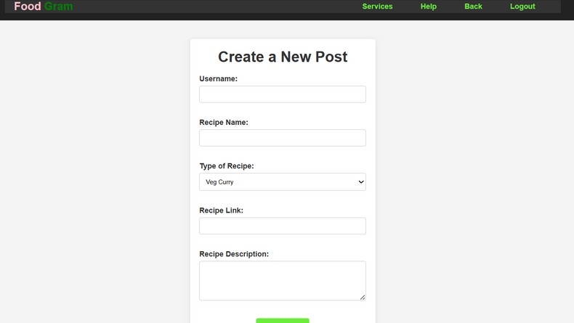
addpost.html
FAUGET
<html lang="en">
<head>
<meta charset="UTF-8">
Username:<input type="text" id="username" name="username" required><br><br> Recipe Name:<input type="text" id="recipe-
name" name="recipe-name" required><br><br> Type of Recipe:<select id="type" name="type">
<option value="Veg Curry">Veg Curry</option>
<option value="Nonveg Curry">NonVeg Curry</option>
<option value="Sweets">Sweets</option>
<option value="Bakery Items">Bakery Items</option>
<option value="Snack Item">Snack Item</option></select><br><br>
Type of Recipe:<input type="text" id="recipe- link" name="recipe-link" required><br><br> Recipe Description:<textarea id="recipe- description" name="recipe-description" rows="4" required></textarea><br><br>
<button type="submit">Create Post</button>
</form></div>
</body>
</html>
<meta name="viewport" content="width=device-width, initial-scale=1.0">
<title>Event Organizer</title>
<link rel="stylesheet" href="https://cdnjs.cloudflare.com/ajax/libs/font-
awesome/5.15.3/css/all.min.css">
<link href="navigation.css" rel="stylesheet">
</head>
<body>
<header>
<nav class="navbar"><div class="logo">
<a href="p1.html"><kk style="color: pink;">Food</kk> <span style="color:
green;">Gram</span></a></div>
<ul class="nav-links">
<li><a href="service.html">Services</a></li>
<li><a href="help.html">Help</a></li>
<li><a href="inner.html">Back</a></li>
<li><a href="index.html">Logout</a></li>
</ul></nav>
</header>
<div class="container">
<h1>Create a New Post</h1>
<form action="addpost.jsp" method="Post">

Slide 16


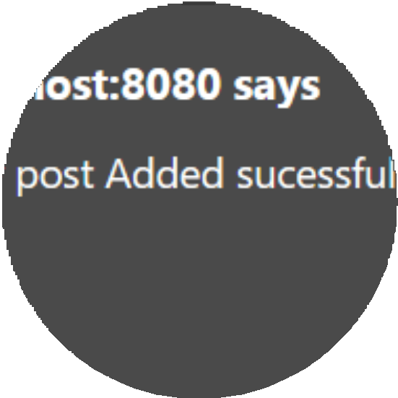
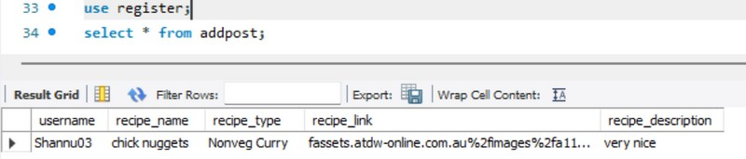
addpost.jsp
<%@ page language="java" contentType="text/html; charset=UTF-8" pageEncoding="UTF- 8"%>
<%@ page import="java.sql.*" %>
<!DOCTYPE html>
<html>
<head>
<title>Adding Post</title>
</head>
<body><%
String username = request.getParameter("username"); String recipename = request.getParameter("recipe-name"); String recipetype = request.getParameter("type");
String recipelink = request.getParameter("recipe-link");
String recipedescription = request.getParameter("recipe-description"); String url = "jdbc:mysql://localhost:3306/register";
String user = "root"; String pass = "root"; try {
Class.forName("com.mysql.cj.jdbc.Driver");
Connection connection = DriverManager.getConnection(url, user, pass);
String query = "INSERT INTO addpost (username,recipe_name,recipe_type,recipe_link,recipe_description) VALUES (?,?,?,?,?)";
PreparedStatement preparedStatement = connection.prepareStatement(query); preparedStatement.setString(1, username); preparedStatement.setString(2, recipename); preparedStatement.setString(3, recipetype); preparedStatement.setString(4, recipelink);
preparedStatement.setString(5, recipedescription); int rowsInserted = preparedStatement.executeUpdate();
if (rowsInserted > 0) { out.print("<html><body>");out.println("<script>"); out.println("alert('New post Added sucessfully!!')");
out.print("window.location.href = 'inner.html';"); out.println("</script>");out.println("</body></html>");
}
else { out.print("<html><body>");out.println("<script>"); out.println("alert('Unable to Post New one')"); out.print("window.location.href = 'addpost.html';"); out.println("</script>");out.println("</body>
</html>");} preparedStatement.close(); connection.close();
} catch (ClassNotFoundException | SQLException e) { e.printStackTrace();}
%>
</body>
</html>

Slide 17

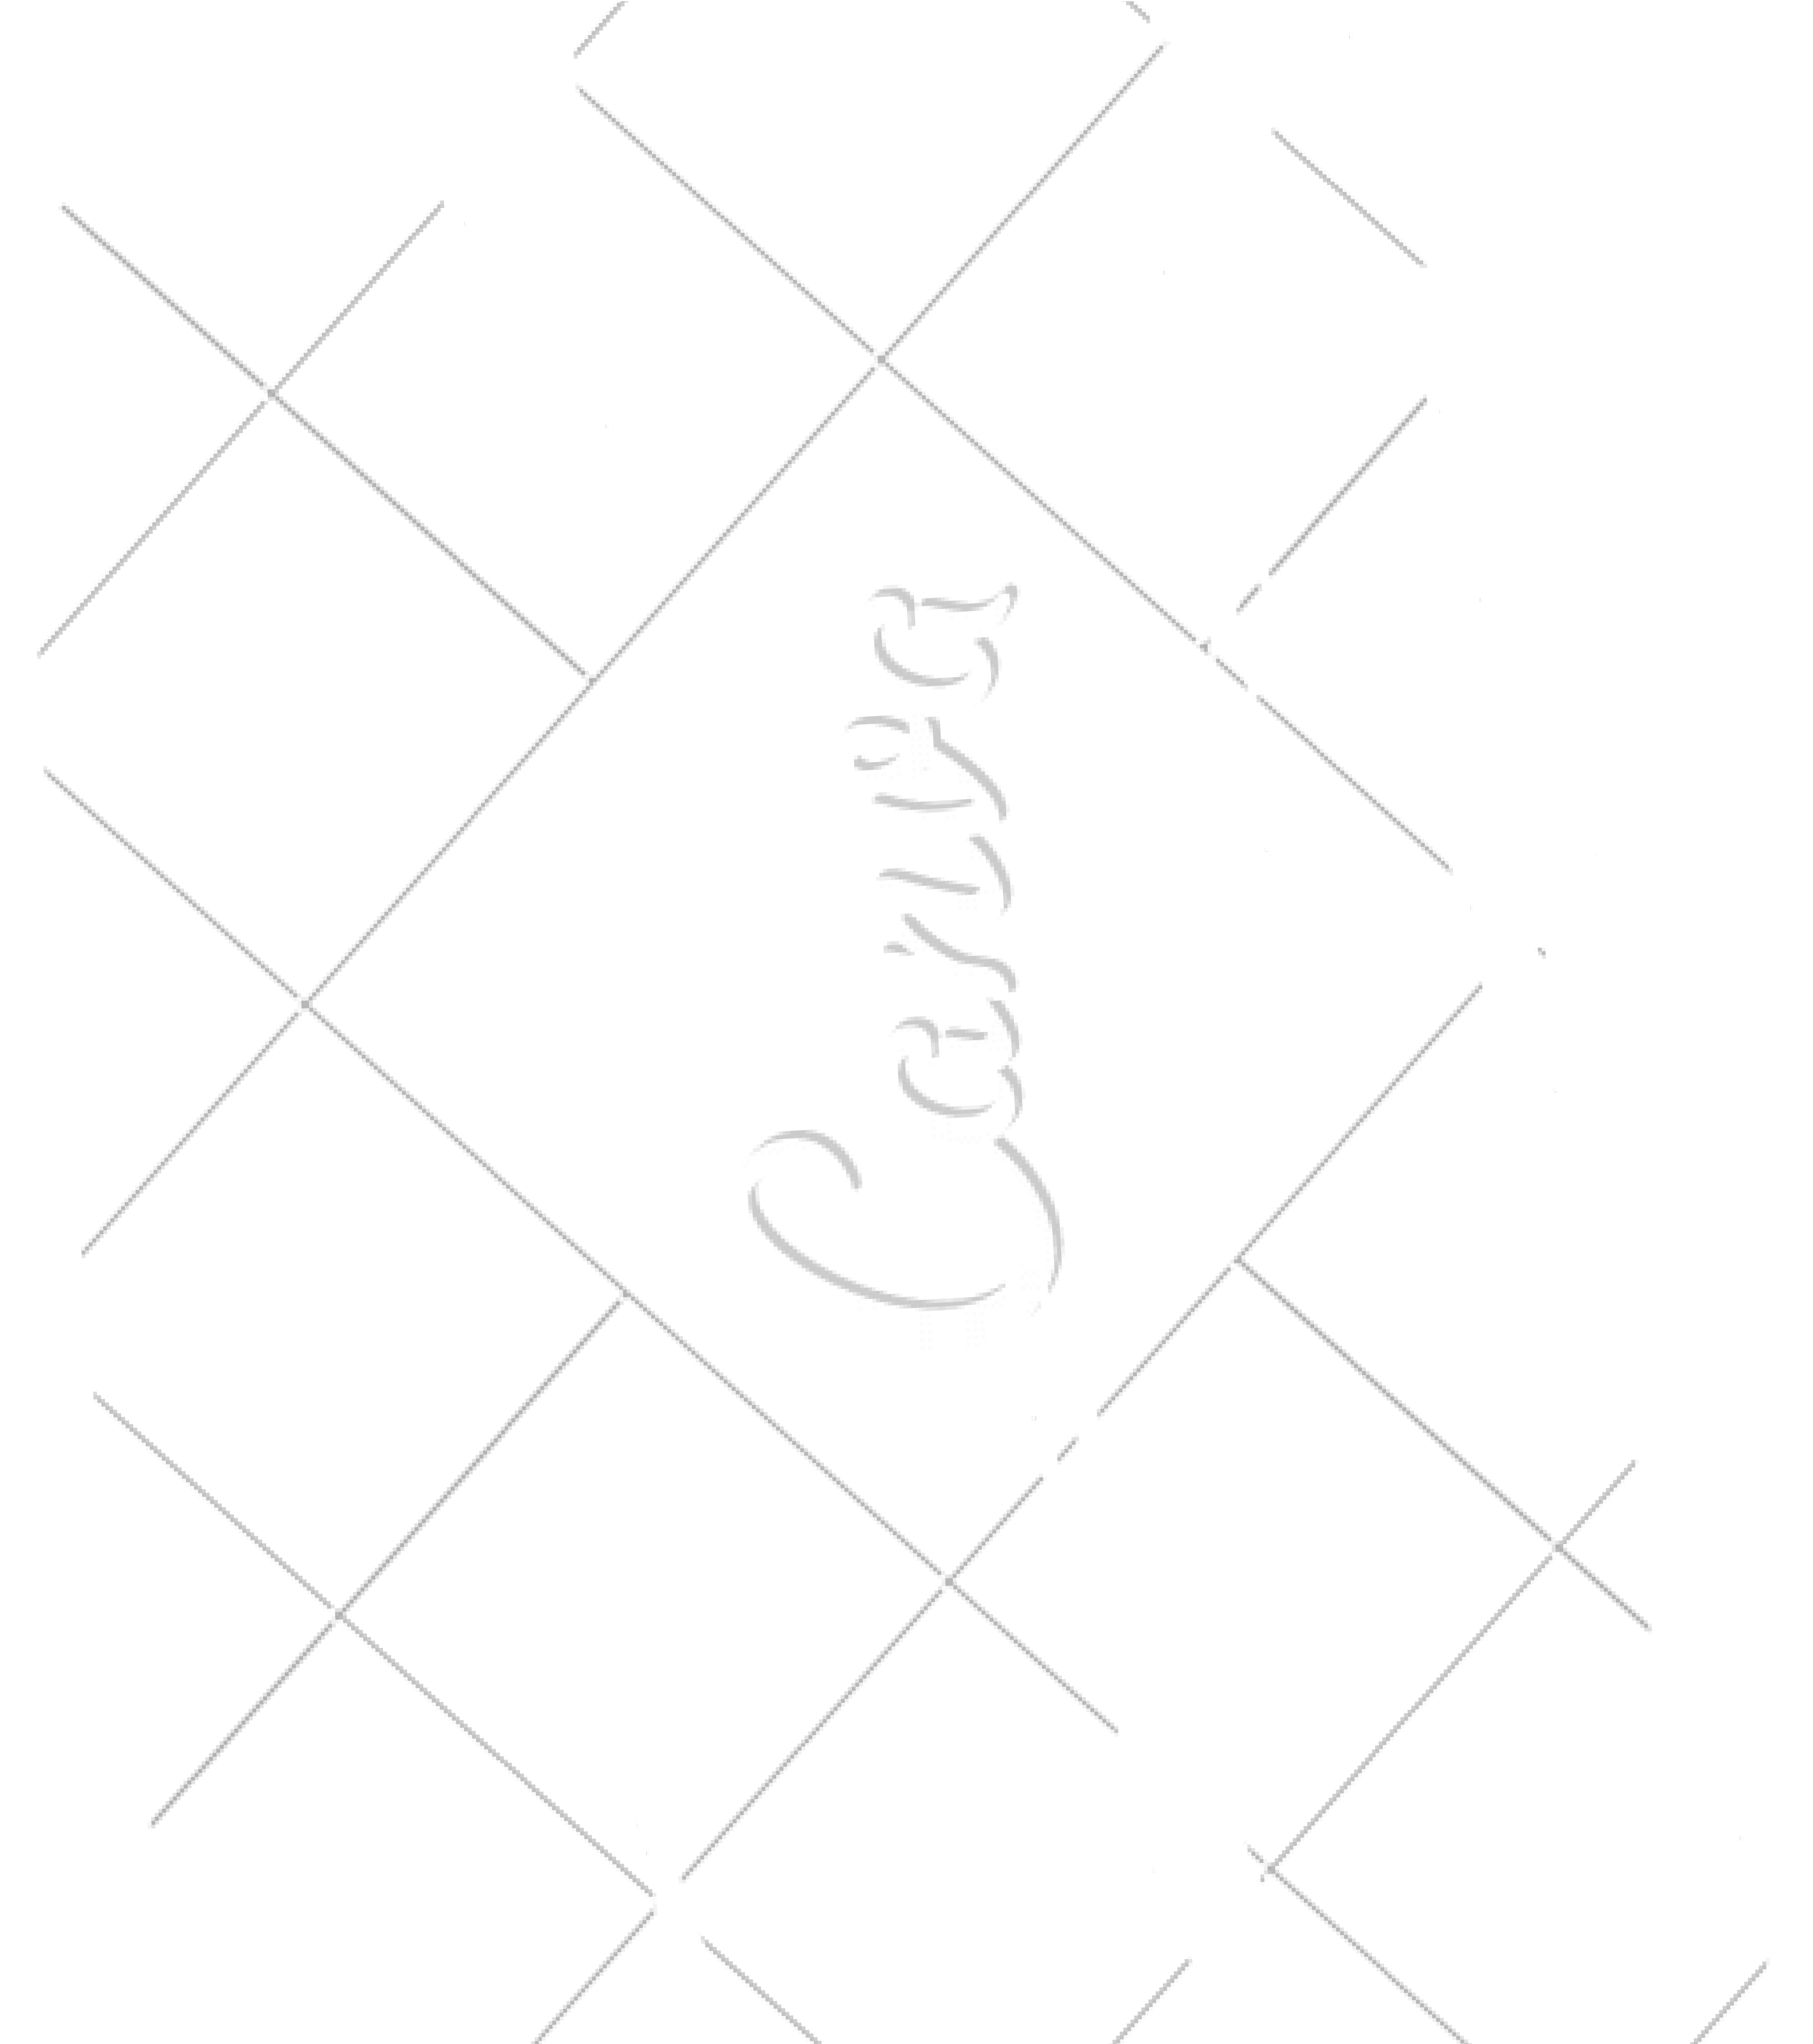
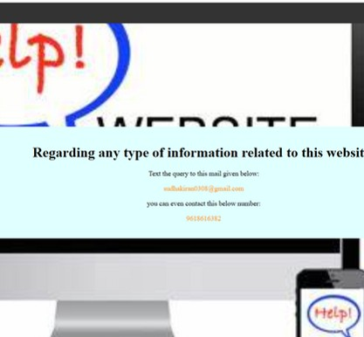
help.html
<html lang="en">
<head>
<title>Help</title>
<link rel="stylesheet" href="navigation.css">
</head>
<body>
<div class="main">
<nav class="navbar" >
<div class="logo">
<a href="index.html"><kk style="color: pink;">Food</kk>
<span style="color: green;">Gram</span></a></div>
<ul class="nav-links">
<li><a href="index.html">Home</a></li>
<li><a href="about.html">About</a></li></ul>
</nav>
<center>
<div class="text" >
<h1>Regarding any type of information related to this website:</h1>
<p>Text the query to this mail given below:</p>
<p><spa style="color:darkorange">sudhakiran0308@gmail.com
</spa></p>
<p>you can even contact this below number:</p>
<p> <spa style="color: darkorange">9618616382</spa><p>
</div>
</center></div>
</body>
</html>

Slide 18

FROM : GROUP - 17

